Slide 1







Do You Git It Now? Version Control & Collaboration with Git & GitHub
OFFICE OF INSTITUTIONAL RESEARCH
August 2020
Office of Institutional Research

Slide 2
Do You Git It Now? Version Control & Collaboration with Git & GitHub
OFFICE OF INSTITUTIONAL RESEARCH
August 2020
Office of Institutional Research

Slide 3
What is Version Control?
Version Control Systems (VCS) help manage changes to files
Database of all changes: who, what, when, and why
Office of Institutional Research

Slide 4
Why use version control?
Help you manage files and projects
Only one version of a file
Office of Institutional Research

Slide 5
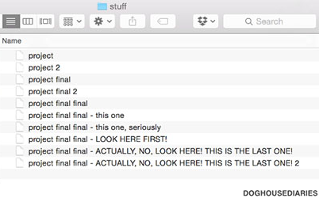

Slide 6
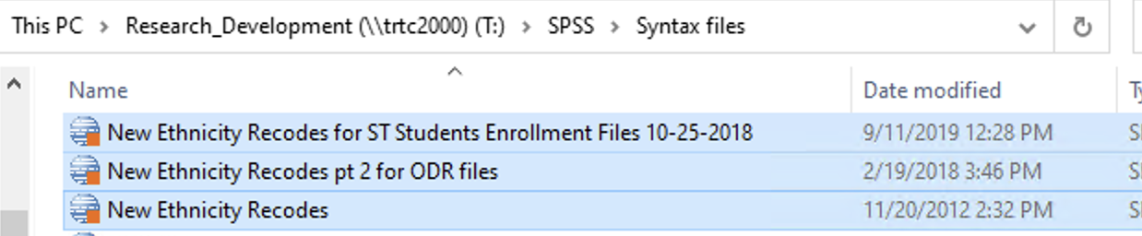
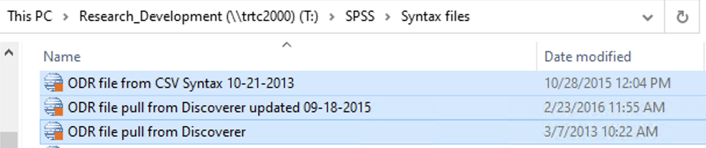

Slide 7
Why use version control?
Help you manage files and projects
Only one version of a file
Undo changes even after saving and closing
All changes are:
Tracked
Linked to the person who made them
Traceable and reversible
Can sync to a cloud service (e.g., GitHub)
Office of Institutional Research

Slide 8
Why use version control?
Help you collaborate
Don’t have to wait for a green light
Work on the same file at the same time
Spot and resolve conflicts
No emailing files back and forth, manually tracking versions
Office of Institutional Research

Slide 9

One of many VCS options
Popular
Robust
Well-documented
Community support
Distributed VCS
Easy integration with GitHub
Office of Institutional Research

Slide 10


Text
Office of Institutional Research

Slide 11
Title
Text
Office of Institutional Research

Slide 12
Title
Text
Office of Institutional Research

Slide 13
Title
Text
Office of Institutional Research

Slide 14
Title
Text
Office of Institutional Research

